Slide 1
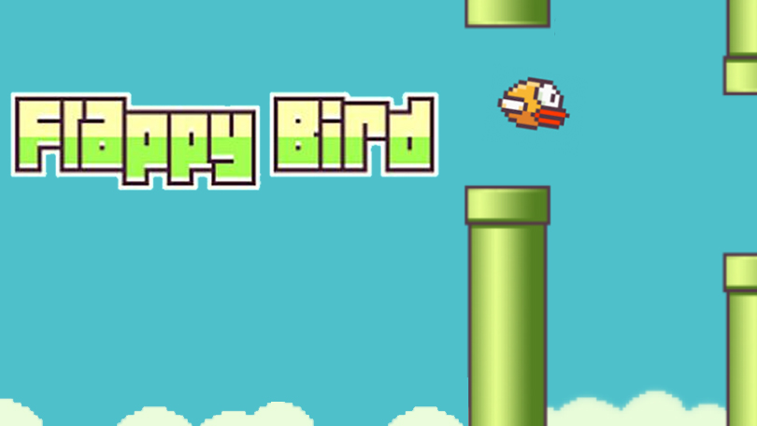
FH Graubünden / Computational & Data Science / Frédéric Kurbel / Januar 2026
Reinforcement
Learning
Tabular Q-Learning in a Discretised Environment

Slide 2

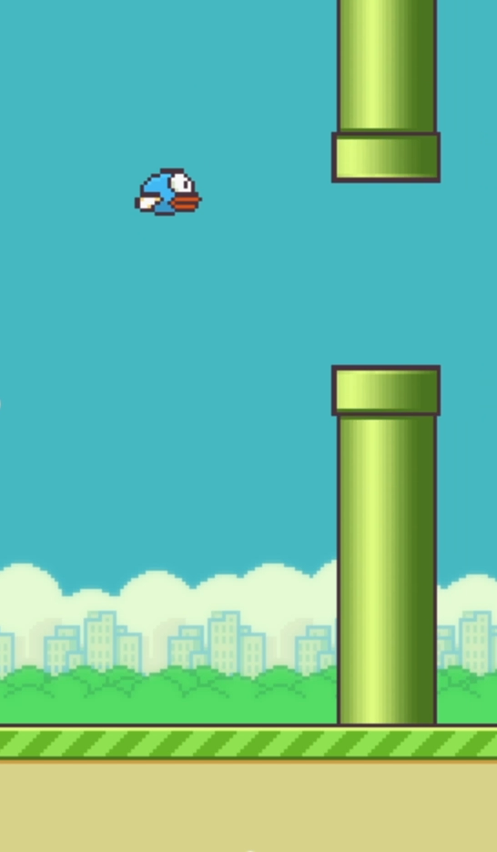
Motivation & problem setting
Flappy Bird as a sequential decision problem
Minimal action space: flap or no flap
Continuous dynamics with immediate failure on mistakes
No recovery after errors → high penalty for suboptimal actions

Slide 3
Reinforcement learning setup
Sequential decision-making problem
Agent observes a state, selects an action, and receives reward and next state
Objective: maximizie expected cumulative return
Formalized as a Markov Decision Process (MDP)
State
Action
Next State
Reward

Slide 4
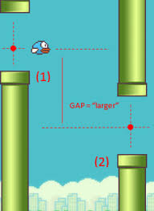
Environment model
Observed state (as implemented):
Vertical distance to next pipe gap
Horizontal distance to pipe
Vertical velocity of the bird
Continous values are discretised into finite bins.
Illustration of state variables (Source: SB Games (2019)

Slide 5
Action space & reward design
Action Space
Reward Function
Two discrete actions
Action 0: no flap (gravity-driven descent)
Action 1: flap (upward impulse)
Minimal action space reduces complexity
Forces the agent to learn when to act, not how much
+1 for every timestep survived
-100 on collision (pipe, ground, ceiling)
Sparse but goal-aligned reward signal
Encourages long-term survival over short-term gains

Slide 6
Q-Learning algorithm
Core Idea
Tabular Q-Learning with a explicit state-action value table
Learning mechanism
Iterative updates based on
Immediate reward
Estimated future return
Off-policy update using the maximum future Q-value
Exploration Strategy
ε-greedy policy during training phase
Gradual transition from exploration to exploitation

Slide 7
Training & experiments
Episodic training (10,000 episodes)
Episode ends on collision
Rewards stored per episode
Additional ablations:
Learning rate α
ε-decay
discount factor γ

Slide 8
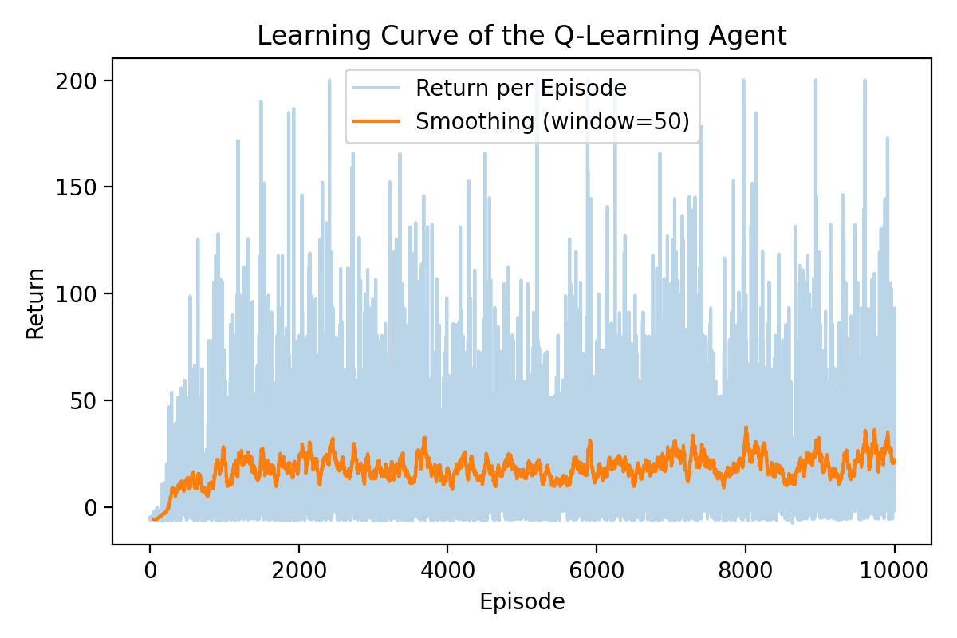
Learning curve
Strong improvement in early training
High variance due to environment dynamics
Convergence after ~2,000-3,000 episodes
Stable long-term behaviour

Slide 9
Discussions & limitations
What works
Limitations
Simple RL method is sufficient
Clear learning signal
Interpretable behaviour
Discretisation loses information
Q-table does not scale
Environment is relatively determininstic

Slide 10
Conclusion & future work
Conclusion
Tabular Q-learning can learn a stable policy
Toy environments are effective learning tools
Future Work
Deep Q-Networks (DQN)
Pixel input instead of abstract state
Inproved reward shaping

Slide 11
Referenzen
https://www.chur.graubuenden.ch/de/uebersicht-ausflugsziele/kantonsspital-graubuenden
https://www.linkedin.com/in/gregory-sean-carigiet/?originalSubdomain=ch
https://www.qnigge.de/news/detail/modul-v/
https://www.ksgr.ch

Slide 12

Fragen?

